Slide 1
Experience Diamond Head
The Big Island’s Most Majestic Sight

Slide 2
Hawaii Volcanoes National Park
Witness the forces of nature at their strongest and be inspired to learn about Hawaii’s geology, culture, and natural history.

Slide 3
Diamond Head Tour Information
The tour will take you as close to the lava flows as allowed
You will hike with trained guides to the edge of a 2,000 degree molten lava flow
Tour precautions
Wear sturdy, covered shoes
Expect uneven terrain

Slide 4
Kilau Volcano Tour
Contact Lehua Hawaiian Adventures for additional information

Slide 5
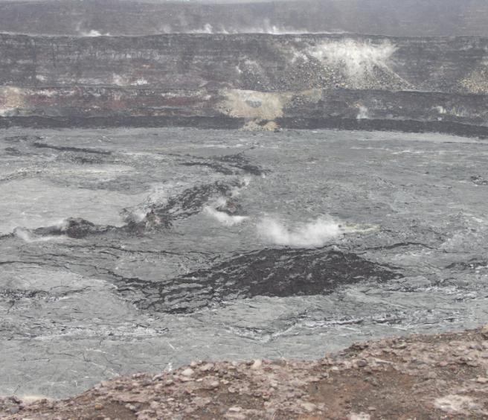
Visit the Smoldering Remains of Kilau
Drive through miles of black molten lava and into Volcanoes National Park where you will experience the sight and smell of the volcano crater.

