Slide 1

Communications and the Internet

Slide 2

Computer Communications
Using a computer to communicate is the most popular application of computers today.
Computer Communications: Process in which two or more computers or devices transfer data, instructions, and information

Slide 3
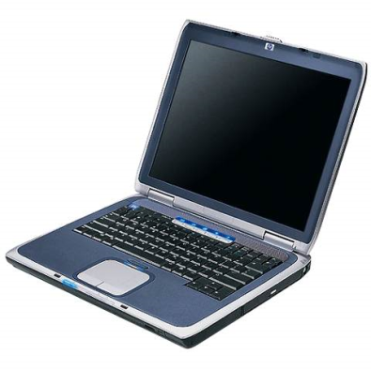
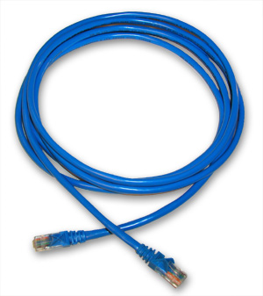
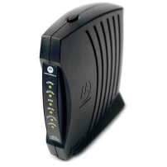
You need:
A sender (computer)
A communications device (modem): connects the sender to the channel
A communications channel (cable, radio waves)
A communications device (modem): connects the channel to the receiver
A receiver (computer)

Slide 4
Computer Communications
Some applications of communications technology:
Internet/Web
E-mail
Blogs
VoIP (Voice Over IP)
FTP (File Transfer Protocol)
Web conferencing

Slide 5
Networks
Network: a collection of computers and devices connected via communications devices and transmission media.

Slide 6
Why Use a Network?
Share hardware (e.g. printer, Internet connection)
Share software
Share data (e.g. files on a hard disk)

Slide 7
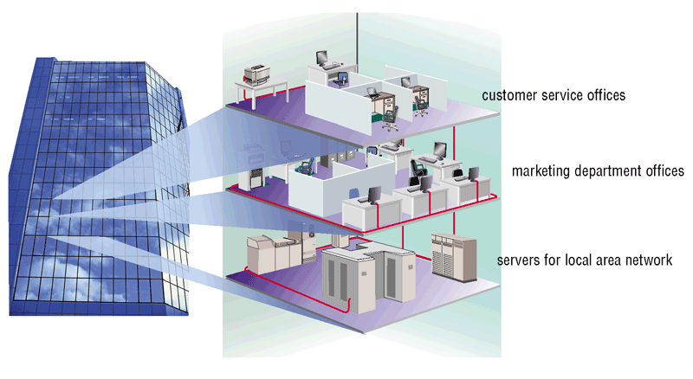
Networks: LAN
A Local Area Network: a LAN is a network in limited geographical area such as home or office building (or a college campus)

Slide 8
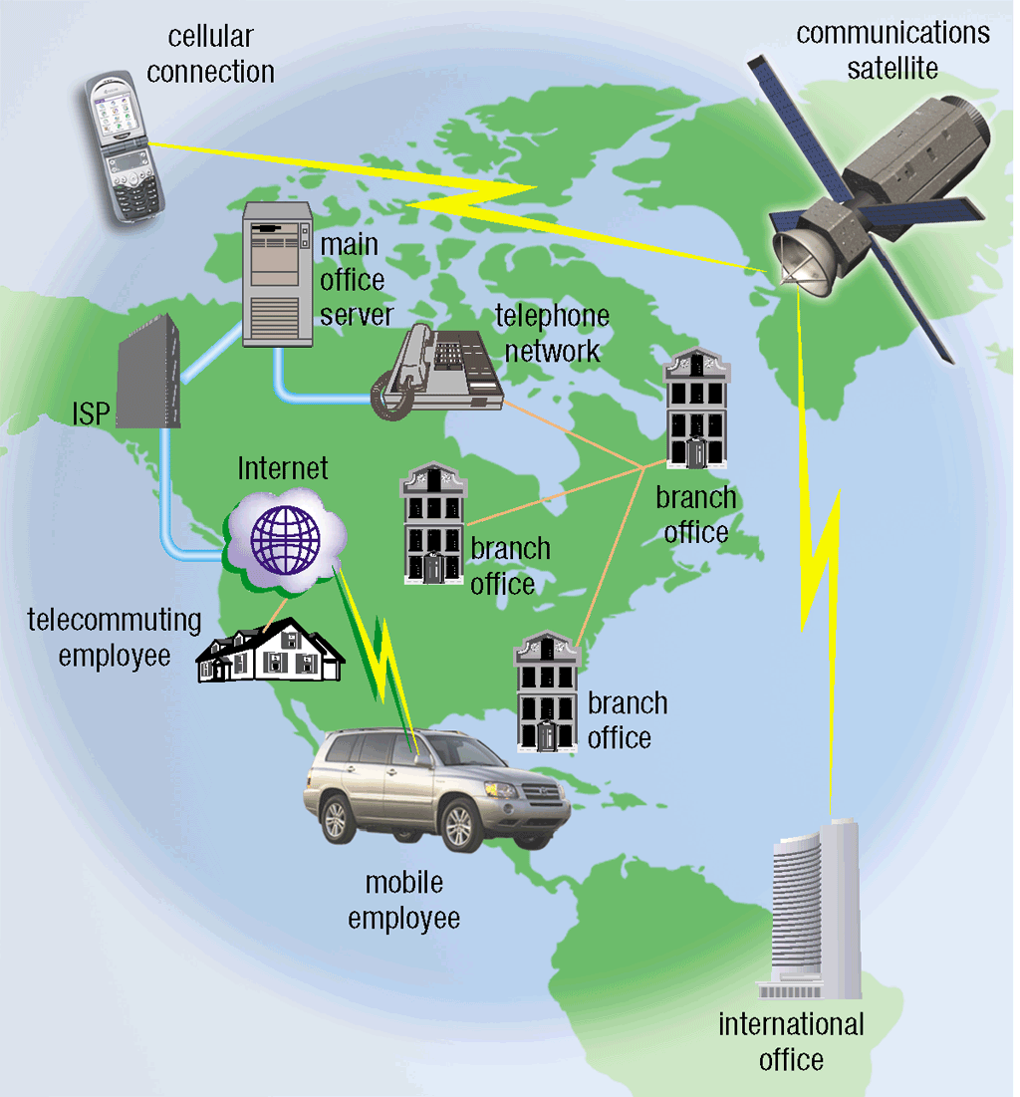
Networks: WAN
Wide Area Network: a WAN is a network that covers a large geographic area using many types of communications media.
The Internet is the world’s largest WAN.

Slide 9
The Internet
Internet: a world-wide network of computer networks.

Slide 10
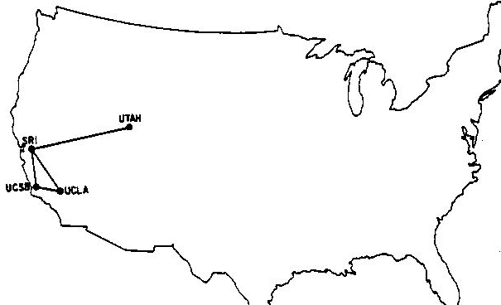
The Internet, 1969

Slide 11
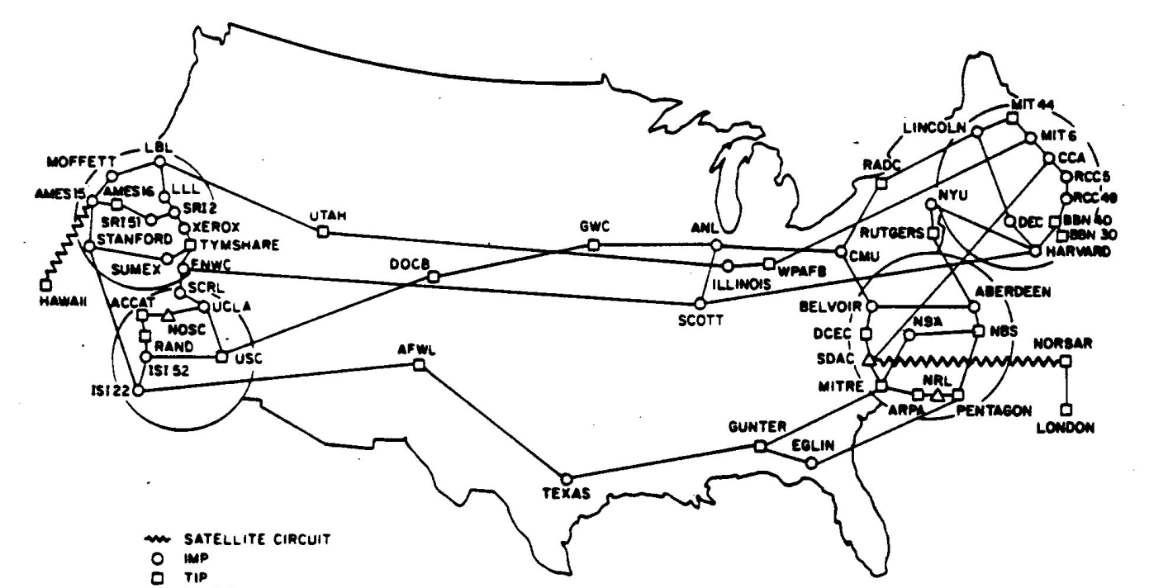
The Internet, 1977

Slide 12
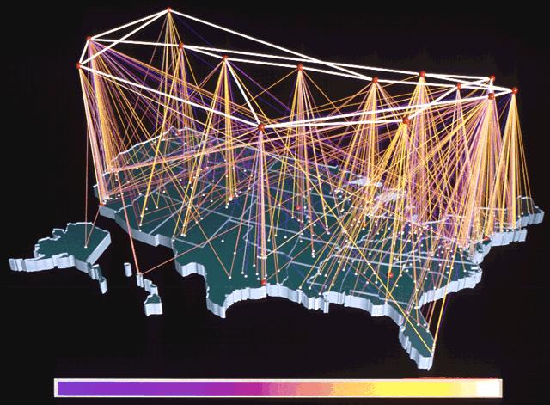
The Internet Today

Slide 13
Internet Growth
1969: Four host nodes
1984: More than 1,000 host nodes
Today: More than 1 billion host nodes

Slide 14
The World-Wide Web
1989. Tim Berners-Lee
1991. HTML 1.0
1992. Lynx browser
1993. Mosaic browser
1994. HTML2
1995. HTML3 (draft never approved)
1995. Internet Explorer.
1998. HTML4
2014. HTML5

Slide 15
Connecting to the Internet
To connect to the Internet, you need three things:
- Hardware to allow you to connect your PC to a communications channel.
- Software that controls the sending and receiving of data.
- Rules for sending data back and forth (called a protocol).

Slide 16
Protocols: the rules
In addition to the hardware, the computers on both ends of the communications line must agree on which rules they will use to send data back and forth. Such rules are called a protocol.
Protocol: a set of rules governing the exchange of information between computer systems.

Slide 17
TCP/IP
Transmission Control Protocol (TCP).
The message is divided into numbered “packets” (like the pages in a book).
Addresses each packet and sends it to its destination.
Packets are re-assembled into the original message when they arrive

Slide 18
TCP/IP
Internet Protocol: a 32-bit addressing scheme.
Each computer on the Internet is given a numeric address that consists of 4 8-bit numbers, called an Internet Protocol (IP) address. An IP address looks like this: 173.194.64.100 * (each number has been translated into decimal)
* IP address of Google

Slide 19
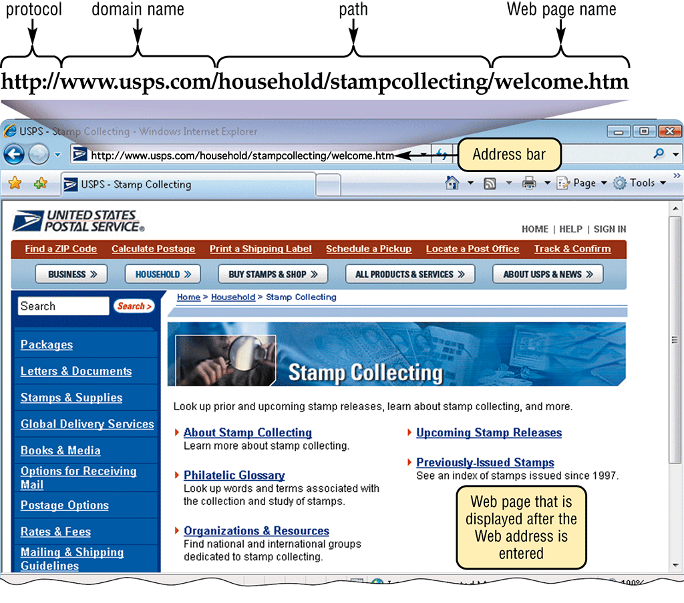
URL: Uniform Resource Locator
URL: A unique address for a web page

Slide 20
URL: Domain Names
12-digit (or longer) IP addresses are impossible to memorize.
The Internet supports the use of a text name for each IP address. This text name is called a domain name.
www.google.com is a domain name.

Slide 21
URL: Domain Names
A domain name is divided into three parts (and they are read from right to left!):
Top-level domain (e.g. com)
Second-level domain (e.g. google)
Third-level domain (e.g. www)
It is possible to have four or more domains, but most domain names consist of three parts.

Slide 22
URL: Top-level Domain
Originally there were six top-level domains:
www.google.COM (commercial—business)
www.briarcliff.EDU (education)
www.whitehouse.GOV (government)
www.comcast.NET (network service providers)
www.w3.ORG (non-profit organizations)
www.af.MIL (military)
More top-level domains have been added and will be added in the future.

Slide 23
More Top-Level Domains
.aero air-transport industry Must verify eligibility for registration; only those in various categories of air-travel-related entities may register.
.asia Asia-Pacific region This is a TLD for companies, organizations, and individuals based in the region of Asia, Australia, and the Pacific.
.biz business This is an open TLD; any person or entity is permitted to register; however, registrations may be challenged later if they are not by commercial entities in accordance with the domain's charter.
.coop cooperatives The .coop TLD is limited to cooperatives as defined by the Rochdale Principles.
.info information This is an open TLD; any person or entity is permitted to register.
.int international organizations The .int TLD is strictly limited to organizations, offices, and programs which are endorsed by a treaty between two or more nations.

Slide 24
More Top-Level Domains
.jobs companies The .jobs TLD is designed to be added after the names of established companies with jobs to advertise. At this time, owners of a "company.jobs" domain are not permitted to post jobs of third party employers.
.mobi mobile devices Must be used for mobile-compatible sites in accordance with standards.
.museum museums Must be verified as a legitimate museum.
.name individuals, by name This is an open TLD; any person or entity is permitted to register; however, registrations may be challenged later if they are not by individuals (or the owners of fictional characters) in accordance with the domain's charter.
.pro professions Currently, .pro is reserved for licensed or certified lawyers, accountants, physicians and engineers in France, Canada, UK and the U.S. A professional seeking to register a .pro domain must provide their registrar with the appropriate credentials.
.tel Internet communication services
.travel travel and tourism industry related sites

Slide 25
URL: Second-level Domain
The second-level domain is usually the name of the organization that purchased the name:
www.YAHOO.com
www.BRIARCLIFF.edu
docs.GOOGLE.com

Slide 26
URL: Third-level Domain
The third-level domain identifies a web server on the host site.
Usually www, but it can be anything.
Examples:
WWW.google.com
APPS.google.com
DOCS.google.com

Slide 27
URL: Protocol
Protocol: http: stands for "hypertext transfer protocol", the protocol (rules) used to transmit pages on the web:
HTTP://www.briarcliff.edu
HTTPS://mail.briarcliff.edu/owa

Slide 28
Static Web Pages
HTML is the language used to create web pages.
A static web page is a page that does not change.
A web page is requested by a browser that sends an HTTP request to a web server.
A web page is returned to the browser by the web server sending an HTTP response.
The web browser's responsibility is to render the web page for the user.

Slide 29
Dynamic Web pages
A dynamic web page is generated on the fly by a program on the web server.
The web server looks at the file extension of the requested page and uses the file extension to determine which application server it should send the request to for processing.
The application server generates an HTML page on the fly and returns it to the web server, which returns it to the user who made the request.

Slide 30
Server-Side Scripting Languages
ASP.NET. Runs on IIS. (.aspx)
JSP. Runs on Apache web server (Unix/Linux). (.jsp)
PHP. Free, open source. Apache. (.php)
ColdFusion. Commercial language. (.cfml)
Ruby. Free, open source. Combined with the Rails framework. (.rb)
Perl. Free, open source. (.pl)
Python. Free, open source. (.py)

Slide 31
Client-Side Scripting Languages
JavaScript. Runs on the client. Implemented by all major browsers.

Slide 32
Communications Software
Web browser: allows Internet users to view web pages
Today’s four most popular browsers (USA):
Chrome (Google)
Safari (Apple)
Firefox (Mozilla)
Edge (Microsoft)
Also:
Opera
Brave
https://gs.statcounter.com/browser-market-share/desktop/united-states-of-america

Slide 33
How a browser retrieves a web page
Step 1. Type in the URL.
Step 2. The web Browser sends the URL to your ISP where it is translated to an IP address and forwarded.
Step 3. The Web server at the destination finds the page and sends it back to the original IP address.
Step 4. The Web browser receives the web page (coded in HTML), interprets the HTML, and displays the page on your computer.

Slide 34
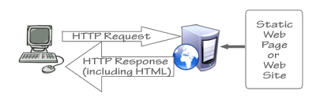
Retrieving a Static Web Page

Slide 35
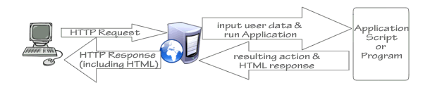
Retrieving a Dynamic Web Page

Slide 36
Some HTML Tags
HTML tags usually come in pairs, one to turn the feature on, one to turn it off.
<h1> Heading 1</h1>
<h2> Heading 2</h2>
<p> paragraph </p>
<b> BOLD </b>
<i> Italic </i>
<u>Underline</u>

Slide 37

The End

